Slide 1
Funding Committee April 28, 2015
Capitol Room 450
10:00 – 3:00

Slide 2
Agenda
Review of Items Proposed for Base Funding
Consensus of Items Included in Base
Discussion of Proposed Categorical Grants
Consensus of Categorical Grants to Include
Review of Characteristics/Initiatives Proposed for Weighting
Consensus of Characteristics/Initiatives to be Weighted

Slide 3
What does it mean to include current funding in the Base?
Instead of districts earning a specific amount of money per FTE segment for each of the programs currently funded, funding would be earned through an average enrollment count.
Each student enrolled would earn a base amount regardless of the services received or the district in which he or she lives. The base amount would be the same amount earned per student statewide.
Districts would have the flexibility to spend the money earned to meet student needs as determined by the local district and without expenditure controls.

Slide 4
Proposed Items to Include in Base
Kindergarten
Primary Grades 1-3
Upper Elementary Grades 4-5
Kindergarten, Grades 1-3 EIP, Grades 4-5 EIP
Middle Grades 6 – 8
High School General Education
Remedial Education 6-12

Slide 5
Base, cont’d. . .
Nursing Services
CTAE
Alternative Education
Central Administration
School Administration
Facility M & O
Media Center Program
20 Days Additional Instruction
Staff & Professional Development
Principal, Staff & Professional Development

Slide 6
Three exceptions . . .
Training and Experience (T & E), State Health Benefit Plan (SHBP), and Teacher Retirement (TRS) would not be earned by average enrollment count.
T & E would continue to be calculated, for a period of time determined by the committee, just as it is currently calculated. The amount of funding calculated, by district, would be added to the student base amount while districts transition from the current teacher salary schedule to a compensation model based on teacher effectiveness, additional duties, Tiered Certification, or other methods tied to effectiveness research.
SHPB and TRS would always continue to be calculated as it is currently and added back to the total student funding.

Slide 7
Innovative Compensation Models are Emerging
Presentation by Marietta City School District
- Dr. Emily Lembeck, Superintendent
- Dr. Dayton Hibbs, Assistant Superintendent

Slide 8
Why are categorical grants needed in the new formula?
Districts currently earn funding outside of the QBE formula for specific costs that are not calculated solely on numbers of students or characteristics of students, but which take other factors into consideration.

Slide 9
Proposed Categorical Grants
Transportation
Equalization
Sparsity
Hold Harmless
State Charter School Supplement – to discuss at a later meeting
Charter System Supplements – to discuss at a later meeting

Slide 10
Why weight for student characteristics?
There are students for which the cost of education is greater than for a typical student.
More resources are required for the state to fulfill its obligation of providing access to the general curriculum for those students. Additional resources are defined as specialized personnel, assistive technology, and/or a specific environment.
Some students have the ability, aptitude, and motivation to succeed in advanced courses. The resources necessary for their education include specialized teacher training, assessment costs, and district participation in a variety of programs

Slide 11
Why weight for state initiatives?
There are some goals that must be achieved for citizens to enjoy the best quality of life possible and that enhance the economic development of a state. These are goals that address the greater good of a state while also addressing the needs of individual children.
An example of an important State initiative is to ensure that all children are reading on grade level by the end of grade 3. This accomplishment increases the chances of future success for the child and enhances the quality of life within the State.

Slide 12
Proposed Weighted Characteristics/Initiatives
K-3
Grades 4 – 8 Committee will identify one as base-funded student.
Grades 9 – 12
Exceptional Students
ESOL
Economically Disadvantaged

Slide 13
What are the best measures to use to acknowledge the effects of poverty on costs of education?
Presentation by GOSA
- Martha Ann Todd, Executive Director
- Sam Rauschenberg, Deputy Director

Slide 14
Other Funding Issues
Georgia’s education budget provides funding for agencies outside of the Local Education Agency (LEA) that support districts and specialized student needs.
Districts’ level of participation in the funding of schools is also a topic that warrants discussion and review.

Slide 15
Other Funding Issues Include
Five (5) Mill Share
RESA Funding
GNETS Funding
State Schools for the Deaf and Blind
Residential Treatment Centers
Pre-Kindergarten Handicapped
Special Needs Scholarships
Virtual Schools

Slide 17
ERS Analysis of Teacher Compensation in Georgia
Based on 2011 data
Presented in 2013

Slide 18
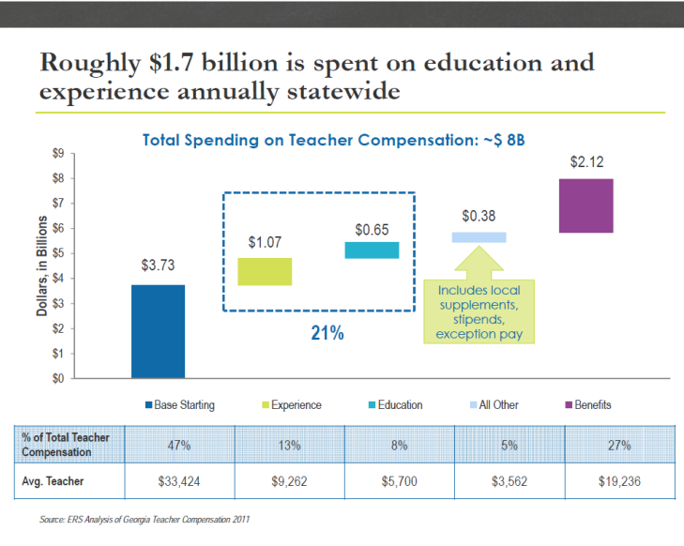

Slide 19
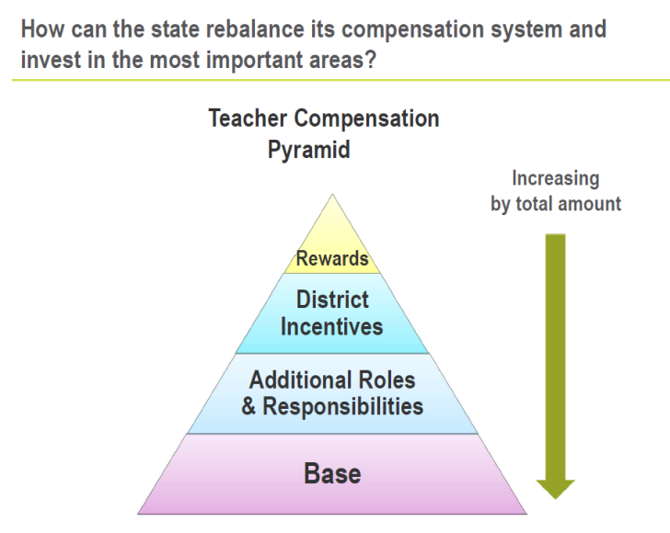

Slide 20
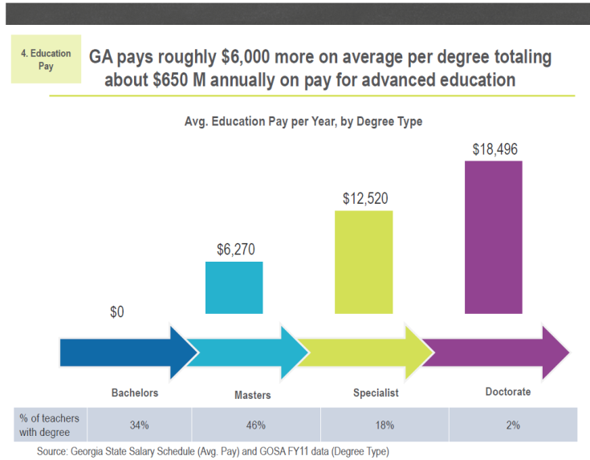

Slide 23
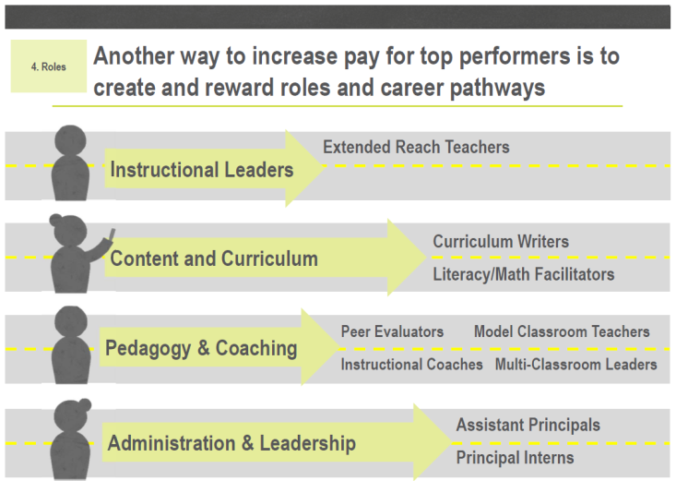

Slide 24
